Slide 1
Git/github Workflow training
Yoji High
February 13, 2019

Slide 2
background
Combination of local and cloud-based tools
Applications:
Collaboration
Version Control
Citing sources/references

Slide 3
Pre-training prep
Git, Bash, Anaconda installed
Shell commands (cd, pwd, ls, mkdir)
Git settings on your workstation (check by git config user.name and git config user.email)
Web browser and your Github.com login (username and password).

Slide 4
Git and github
Git – Set of tools used to track changes to files through commands run in Terminal
Github – cloud-based version of Git
Notes:
About Git & GitHub
Git is tool that is used to track changes in files (a process called version control) through a suite of commands that you can execute in the Terminal. GitHub is the cloud-based version of Git, which can be used to store files in the cloud to access them from any computer and to share them with others.
Git and GitHub use repositories (i.e. directories of files stored on Github.com) to manage and store files.
Data Tip: A GitHub repository is a directory of files and folders that is hosted on Github.com.
GitHub allows you to store a set of files as Github repositories in the cloud (on the GitHub servers) and to work with these repositories locally on your computer using Git commands in the Terminal.
Having a copy of a set of files as repositories in the cloud is ideal because:
There is a backup: If something happens to your computer, the files are still available online
You can share the files with other people easily
You can even create a Digital Object Identifier (DOI) using third party tools like Zenodo to cite your files or ask others to cite your files. You can also add these DOIs to your resume or C.V. to promote your work.

Slide 5
Overview of workflow
Access parent repository
Submit pull request to request changes
Github.com (cloud)
Fork repository into your GitHub account
git push to send changes to Github
Clone repository to your local workstation
Local Workstation
Modifications to repositories
git status to check changes
git add to add changes to staging
git commit to commit changes
Notes:
Fork a user’s repository to create a copy of another user’s files on Github.com
Copy files from Github.com to your local computer (git clone)
Make changes to files locally on your workstation (in a repository)
check the status of changed files in a repository
add changed files to version control tracking
commit the changed files to your local repository
push those changed files from the local copy of a repository to the cloud (Github.com)
Submit a pull request to the owner of the original repository to request changes (if applicable)

Slide 6
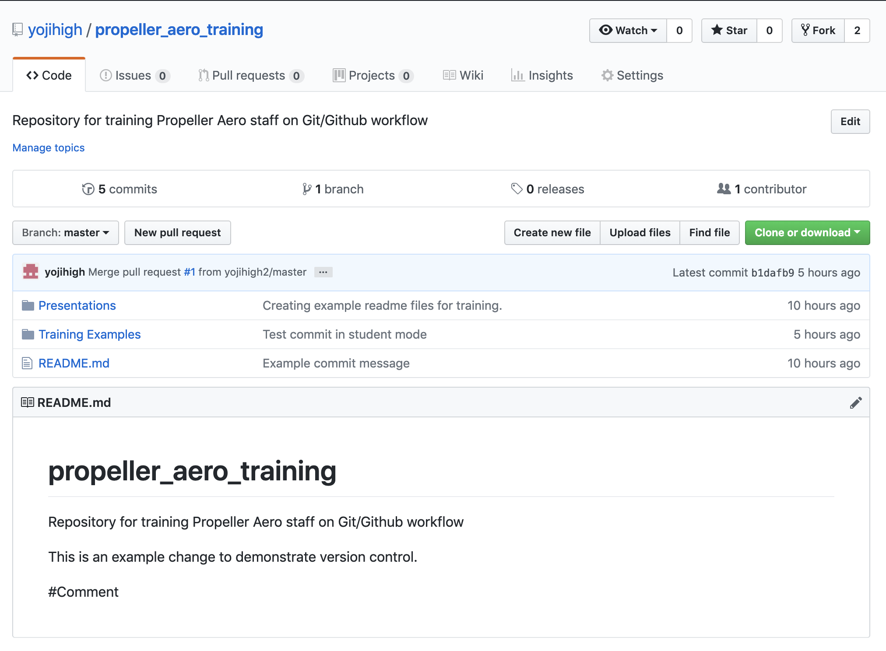
Step 1. access repository to clone
Available on Github.com
Documentation available through README (usually)

Slide 7
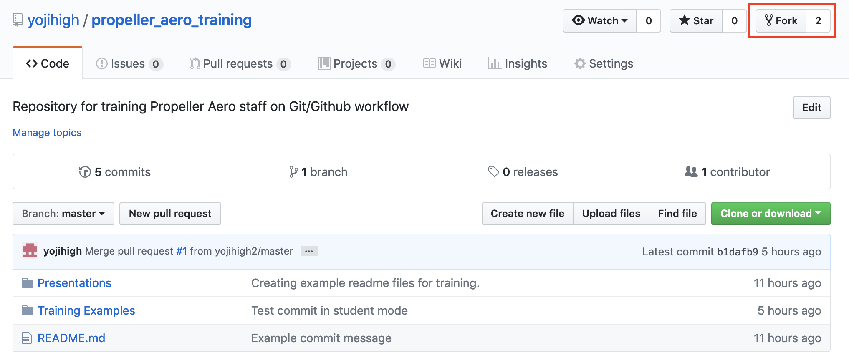
Step 2. Fork repository
Create a copy of someone else’s repository on your own Github account
Notes:
The ability to fork a repository is a great benefit of using GitHub repositories because the forked repository is linked to the original. This means that you can download new updates from original to your forked repository as well as suggest changes to the original repository, which can be reviewed by the owner of that repository.
The URL link to a GitHub repository always follows the same format: https://github.com/username/repositoryname.
You can fork an existing Github repository from the main Github.com page of the repository that you want to copy.
On the main Github.com page of the repository, you will see a button on the top right that says Fork. The number next to Fork tells the number of times that the repository has been copied or forked.
Click on the Fork button and select your Github.com account as the home of the forked repository.

Slide 8
Step 3. Clone repository
Download the forked repository (i.e. your copy of a GitHub repository) from Github.com onto your computer.
Substeps:
Use bash to change your current working directory (where do you want the repository to live?)
Copy a github repository URL from Github.com
Run the git clone command in the Terminal
Notes:
Note: When you run the git clone command, where you run it will be where the repository will live on your workstation.

Slide 9

Step 4. Do some work
Let’s make some changes to the files locally (modify a text file, add a file)
Notes:
To the Student_X README file:
A bullet list with:
A bold word for Author: and then add text for your name.
A bold word for Date: and then add text for today’s date.

Slide 10
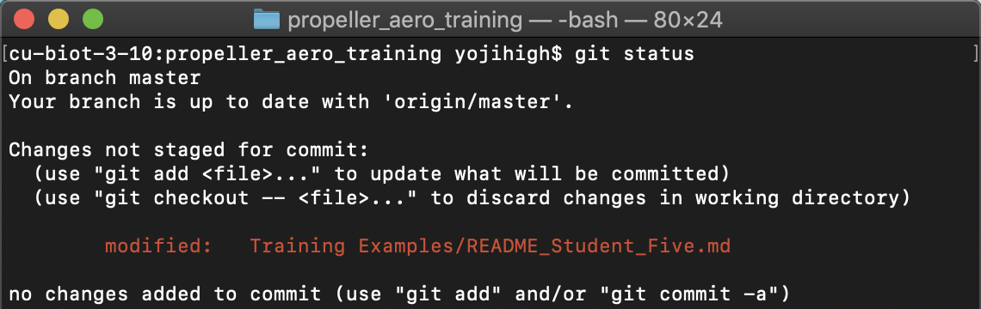
Step 5. Check the status of changes
Use git status command to quickly check whether files in your local repository have been changed
Notes:
Run the command git status to check that changes have been made to your files that have not been pushed back to GitHub.

Slide 11
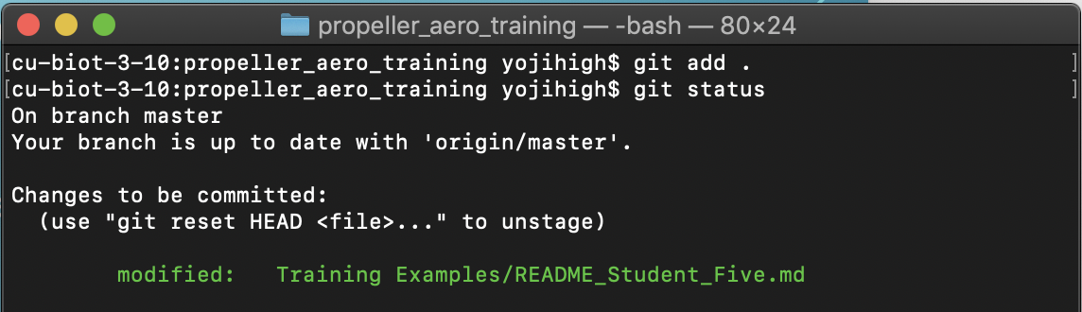
Step 6. Add changes to staging
Use git add command to add a modified file in your working directory and place the modified version in a staging area.
Notes:
Add Files
You can add an individual file or groups of files to git tracking. To add a single file, use:
git add file-name.extension.
Ex. Git add “README_Student_5.txt”
You can also add all of the files that you have edited at the same time using:
git add .
However, use git add . with caution. Be sure to review the results from git status carefully before using git add .. You do not want to accidentally add files that you do not want to change in the GitHubrepository.

Slide 12
Step 7. Commit local changes
Use git commit to take everything from the staging area and make a permanent snapshot of the current state of your repository that is associated with a unique identifier.
Notes:
Commit Files
Once you are ready to make a snapshot of the current state of your repository, you can use git commit.
The git commit command requires a commit message that describes the snapshot (i.e. changes) that you made in that commit. A commit message should outline what changed and why. These messages:
help collaborators and your future self understand what was changed and why
allow you and your collaborators to find (and undo if necessary) changes that were previously made.
Since you are not committing a lot of changes, you can create a short one line commit message using the -m flag:
git commit -m "Updating title and author of README example file"

Slide 13
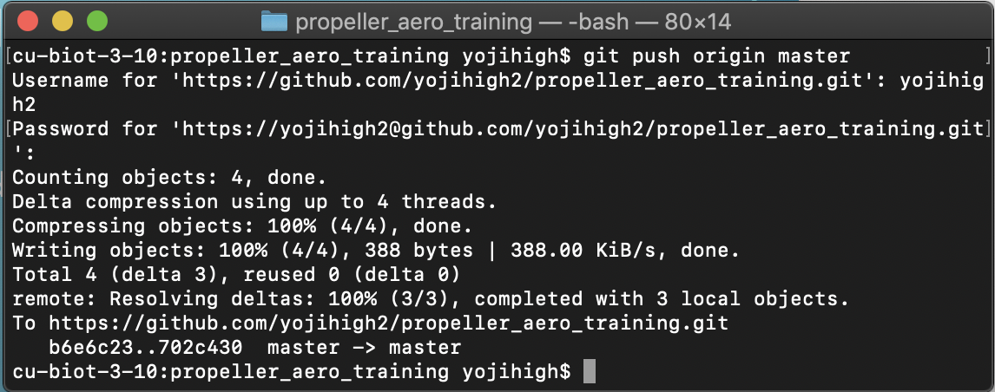
Step 8. push changed files to github
Use git push to push changes committed locally in your repository to the repository on Github.com
Syntax: git push origin master
Notes:
After you have pushed your commits, visit your repository on https://github.com/yourusername/propeller-aero-training and notice that your changes are reflected there. Also notice that you have access to the full commit history for your repository!

Slide 14
Step 9. submit a pull request to merge changes
Currently, changes exist on Github, but on your local (cloned) repository.
In order to request these changes to be incorporated into the parent directory, you will submit a pull request.
Notes:
Pull requests are the heart of collaboration on Github.com. When you open a pull request, you’re proposing your changes and requesting that someone review and pull in your contribution and merge them into their project.
Pull requests show diffs, (differences), of the content between your repo and the repo that you are submitting changes to. The changes, additions, and subtractions are shown in green and red.
Step 1 - Start Pull Request
To begin a pull request (PR), click the New pull request button on the main page of your forked repository
Step 2 - Select Repository to Update
Next, you need to select which repository you wish to update (the base repo) and which repository contains the content that you wish to use to update the base (the head repo).
Head vs Base
Base: the repository that will be updated; changes will be added to this repository.
Head: the repository containing the changes that will be added to the base.
One way to remember this is that the “head” is ahead of the “base”. So you must add from the head to the base.
Step 3 - Verify Changes
When you compare two repos in a pull request page, GitHub provides an overview of the differences (diffs) between the files. Look over the changes and make sure nothing looks surprising.
You can also click on the commit titles to see the specific changes in each commit.
Step 4 - Create New Pull Request
If you are adding new commits to base repository (e.g. yojihigh/propeller_aero_training), then the “Create Pull Request” button will be available. Click the green “Create Pull Request” button to start your pull request.
Step 5 - Describe Your Pull Request
Add a title and write a brief description of your changes. When you’re done with your message, click “Create Pull Request”.

Slide 15
Recap of full workflow
Key concepts
Collaboration
Version tracking
Documentation for each step

Slide 16
Questions?

Slide 17
Next steps
Optional challenge to be emailed later today
Questions you forgot? Reach out! help@propelleraero.com

